Slide 1
Software Development Project AAPP006-4-2-SDP (VD1)
Revision 1

Slide 2
Problem Statement
A problem definition usually contains some sort of problem statement, summarized in a paragraph or two.
This is followed by a series of issues, or major, independent pieces of the problem.

Slide 3
Objective
Problem Statement or issues are followed by an aim and a series of objectives that match the issues point by point. Issues are the current situation; objectives are the desired situation.
Objective can be measureable to prove that the objective achieve in verification and validation phase.
How progress is measured:
What tool or device (surveys, tests, data from other sources) will be used to measure the expected changes. Ensure that your department has the resources/capacity (time, staff, funding, etc.) to perform the measurement.
Proficiency level:
Identify the criteria for success.

Slide 4
Propose Solution
Your proposed solution should relate the current situation to a desired result and describe the benefits that will accrue when the desired result is achieved.
Begin your proposed solution by briefly describing this desired result.
The solution section addresses how your project will solve the client’s problem.

Slide 5
Project Scope
Determining the project scope means defining the specific boundaries, or extent, of the project. For example:
Very general:-
Payroll is not being produced accurately.
The project scope is to modify the accounts receivable system.
Very specific:-
Overtime pay is not being calculated correctly for production workers on the second shift at the Rawang plant.
The project scope is to allow customers to inquire online about account balances and recent transactions.

Slide 6
Sample Case
In Sunflower Kindergarten, parents will visit the school to make a registration during the school opening week. An admin then help to register the children. Parents need to bring all necessary documents or they are unable to register and have to come back another day for registration process.
1.1 Problems
1- Difficulties to come for registration (with elaboration)
2-Tend to forget the document that need to be prepared (with elaboration)
1.2 Objectives
1- To help parents easily register their child (elaborate more)
2- To ensure all documents can be prepared during the registration (elaborate more)
1.3 Proposed Solutions
1- Create an online registration system allows parents to register online during registration period (with elaboration)
2- Allow parent to upload the necessary documents during registration process (with elaboration)

Slide 7
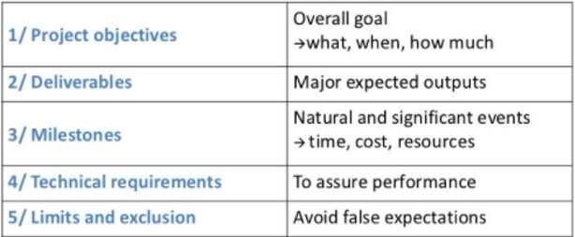
Project Scope - Checklist
the things the project delivers to the user and those the project generates itself, respectively
possible limitations

Slide 8
Sample Case
Components | Details
Project Objectives | **Discussed in section 1 sub topic 1.3 (Objectives)
Deliverables | 1- Product: Parents Must be able to make apply for school admission for child online Must be able to upload all necessary document for application online Admin / Staff Must be able to approve any online registration request Must be able to make any registration for walk-in parents 2- User Manual 3- Instruction and installation manuals
Milestones | **Discussed in section 3 sub topic 3.2 (Gantt Chart)
Technical Requirements | Local server (Appserv), Database(SQL Server), etc
Limits / Constraints | **Cover in section 5 sub topic 5.2 (Limitation)
Necessary Changes | Product: Parents -Possibility to add able to update the registration before approval

Slide 9
System Hierarchy Diagram
It's used to define the elementary functions and how functions are related to one another.
Map out a functional hierarchy structure of a system - Horizontally or Vertically

Slide 10
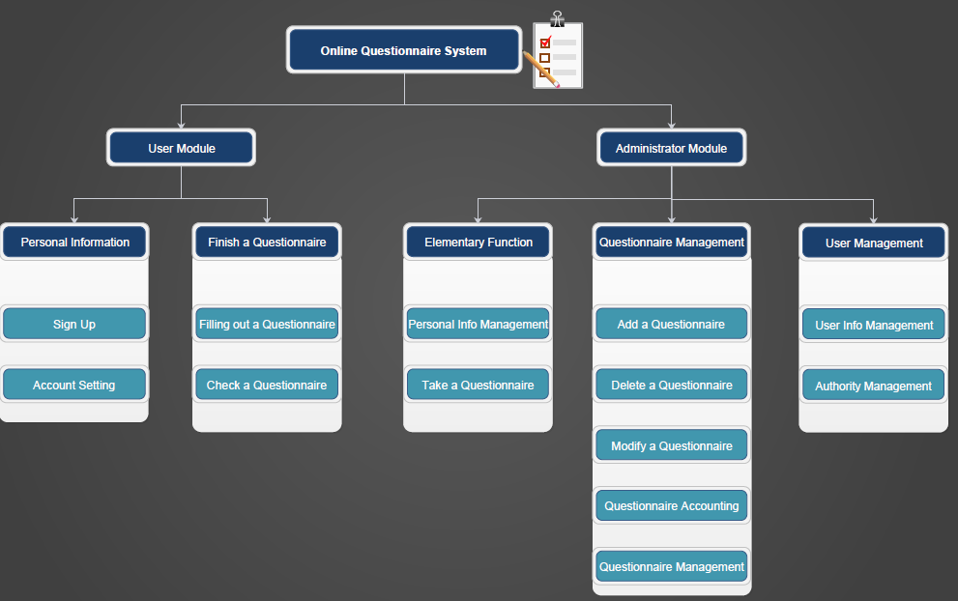
Vertical Hierarchy Diagram

Slide 11
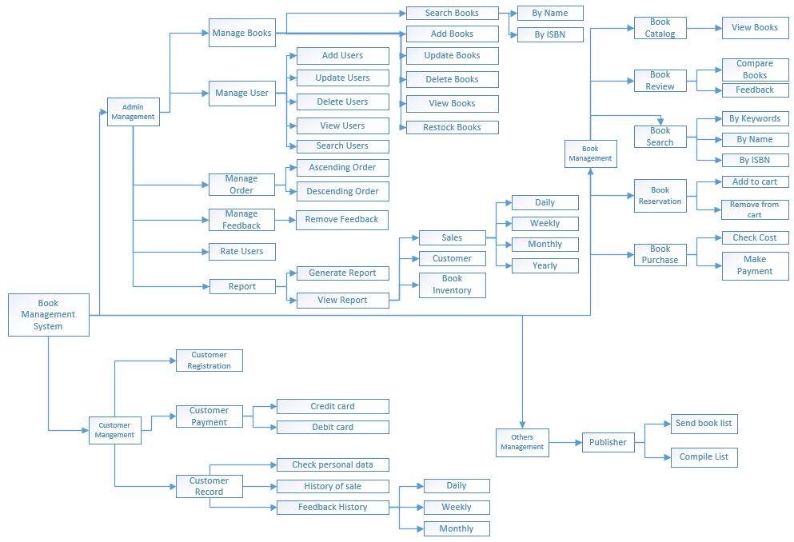
Horizontal Hierarchy Diagram

Slide 12
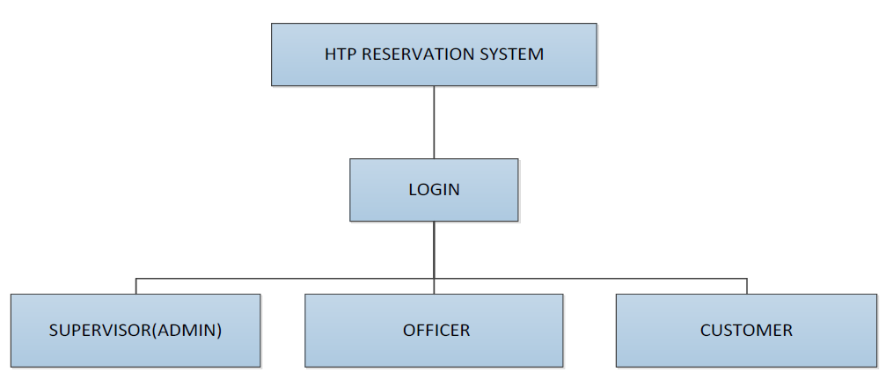
All Users - Hierarchy Diagram
Sunflower Kindergarten
Login
Registration
Parents
Admin

Slide 13
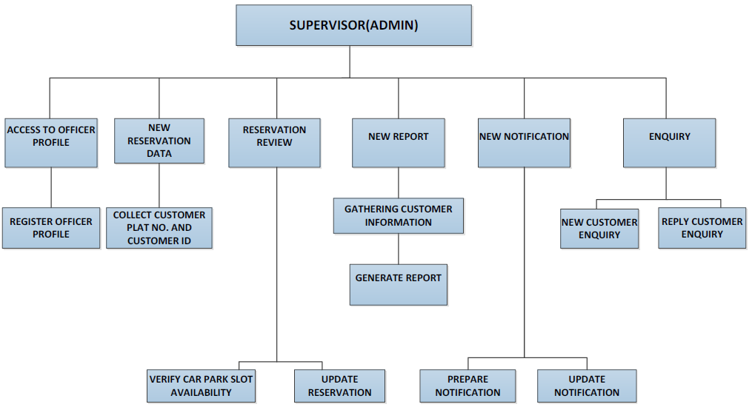
A User Modules - Hierarchy Diagram
Parents
Update Application
Register Children
Upload Documents

Slide 14
Gantt Chart
Horizontal axis : Time and duration
Vertical axis : Activities - arranged from top to bottom in the order of their start date.
Horizontal position : start and end of the activity.
Length : Duration
Darkened portion : part of the activity that has been completed
“c” is marked when the activity is fully completed
Gantt Chart : It does not indicate activity dependencies

Slide 15
Gantt Chart
black bars – summary tasks – project phases
red bars – tasks that are critical to the schedule – any extension to the duration will delay other tasks
blue bars – tasks that are not critical to the schedule – they have slack time – delays will not affect other tasks & project as a whole
red arrows – prerequisites between two critical tasks
blue arrows – prerequisites between two non-critical tasks
teal diamonds – milestones – signifies the end of some significant task / deliverable

Slide 16
Gantt Chart

Slide 17

Question and answer session

Slide 18
What we will cover next
Revision on Diagram

